Slide 1
CPI for All Urban Consumers: Information Technology, Hardware and Services in U.S. -
Full Time Series Analysis
By Matthew Colao

Slide 2
Table of Contents
01.
The Problem
02.
The Data
03.
Exploratory Data Analysis
04.
Methodology & Models
05.
Final Model Selection
06.
Forecast
07.
Conclusion

Slide 3
01.
The Problem

Slide 4
Use for forecasting?
Business Planning
Economic Analysis
Industry Innovation
Forecasting this can be useful to consumers and businesses to anticipate price changes and make informed purchases around technology
Monitoring forecasting can help government agencies see how tech affects the economy, its policies, and how much it contributes to inflation.
Technology evolves faster than anything today so forecasting this is useful for businesses, firms, investors, and researchers so they are informed about the market and ensuring its competitiveness

Slide 5
Why is it Important to Me?
The tech space is interesting and always evolving, as we clearly see today with a multitude of advancements, most notably the Artificial Intelligence space. Unlike traditional CPI categories, technology prices tend to decrease over time due to the innovation and evolution. By monitoring and understanding the forecast, I can make better decisions regarding buying or upgrading to new tech. In the border scheme of things, being able to track the tech market can help make both personal and business decisions around innovation and spending.

Slide 6
02.
The Data

Slide 7
The Data: Overview
Source
Periodicity
Observations
Collection Process
Originates from the Bureau of Labor Statistics (BLS) but was retrieved from the online database Federal Reserve Economic Data (FRED)
Contains monthly time series data that has not been seasonally adjusted
Contains 435 observations from Dec 1988 to Feb 2025
Prices for consumer electronics are surveyed across retail stores and online platforms. CPI is then calculated and then uploaded monthly.

Slide 8


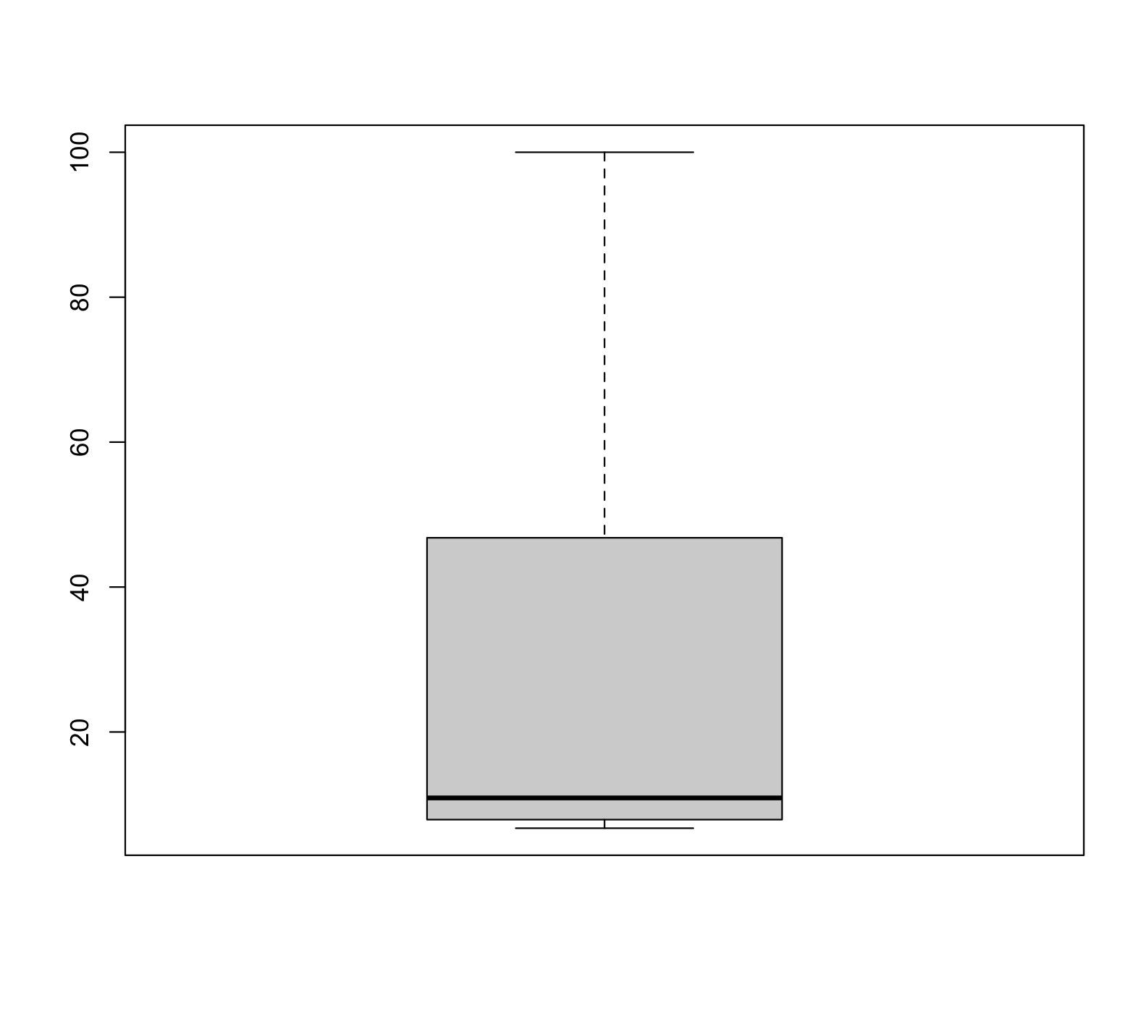
The Data: Preprocessing
Null Values
Duplicates
Outliers
There are no null values.
There are no duplicates
There are no outliers

Slide 9
03.
Exploratory Data Analysis

Slide 10
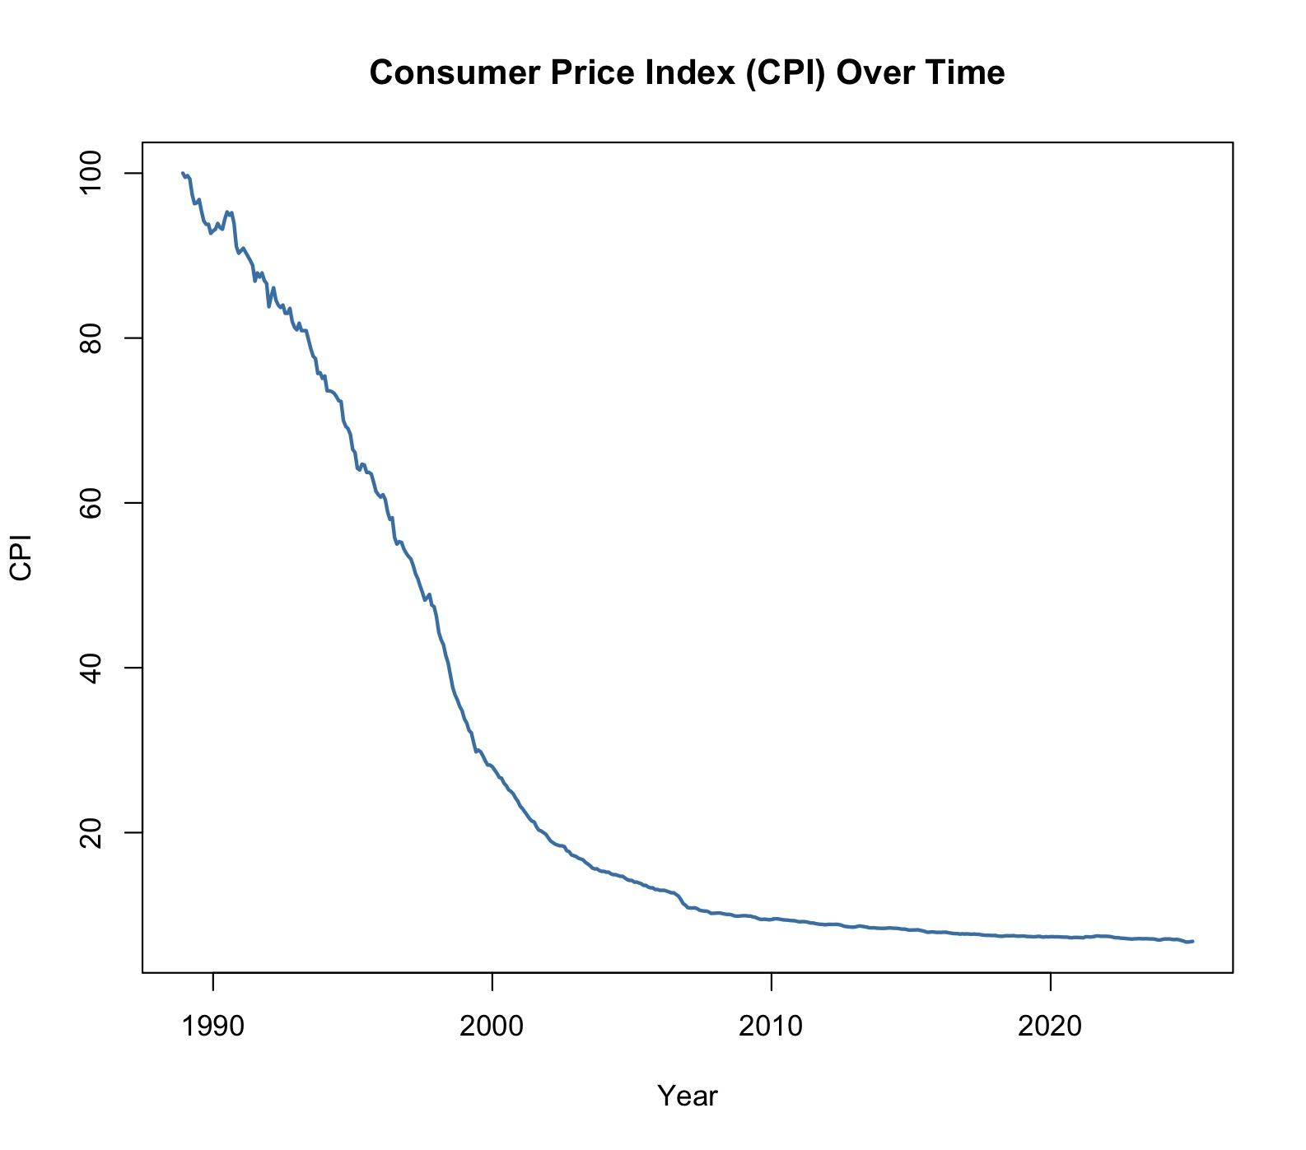
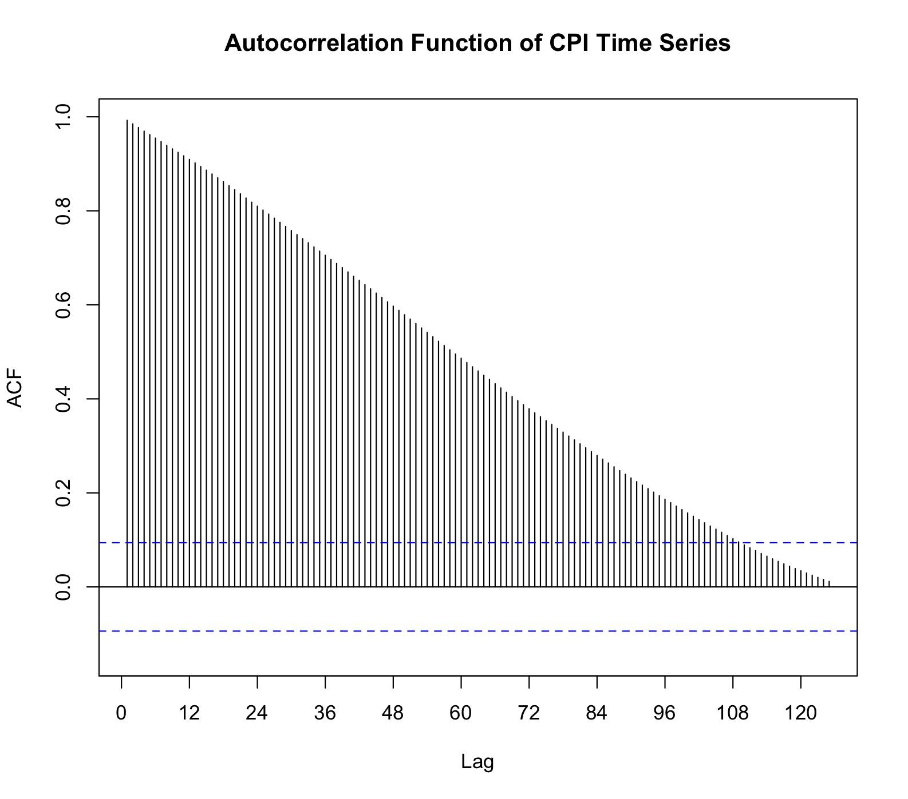
EDA: Plot & ACF
Shows significant drop before 2000
Trend levels out after
Significant autocorrelation
Cut off(window) everything before lag 109

Slide 11
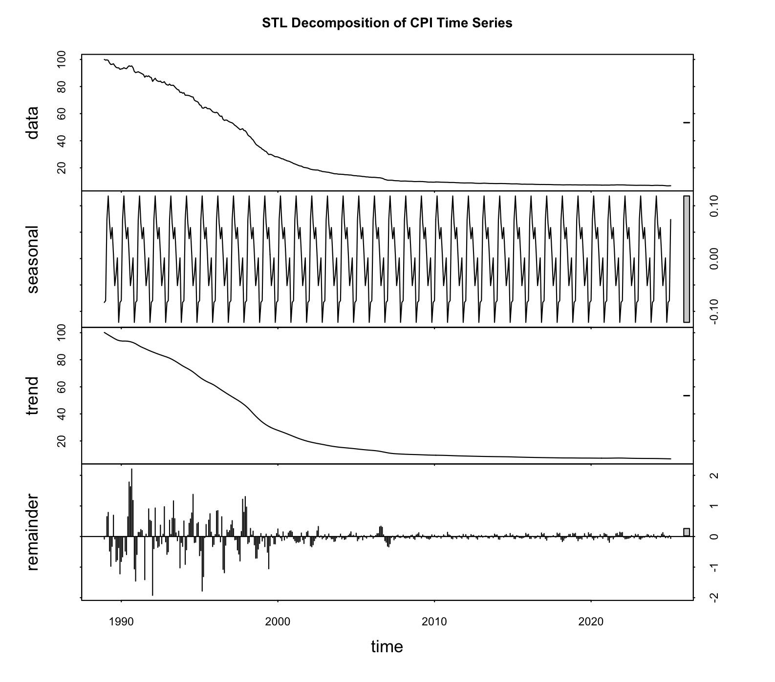
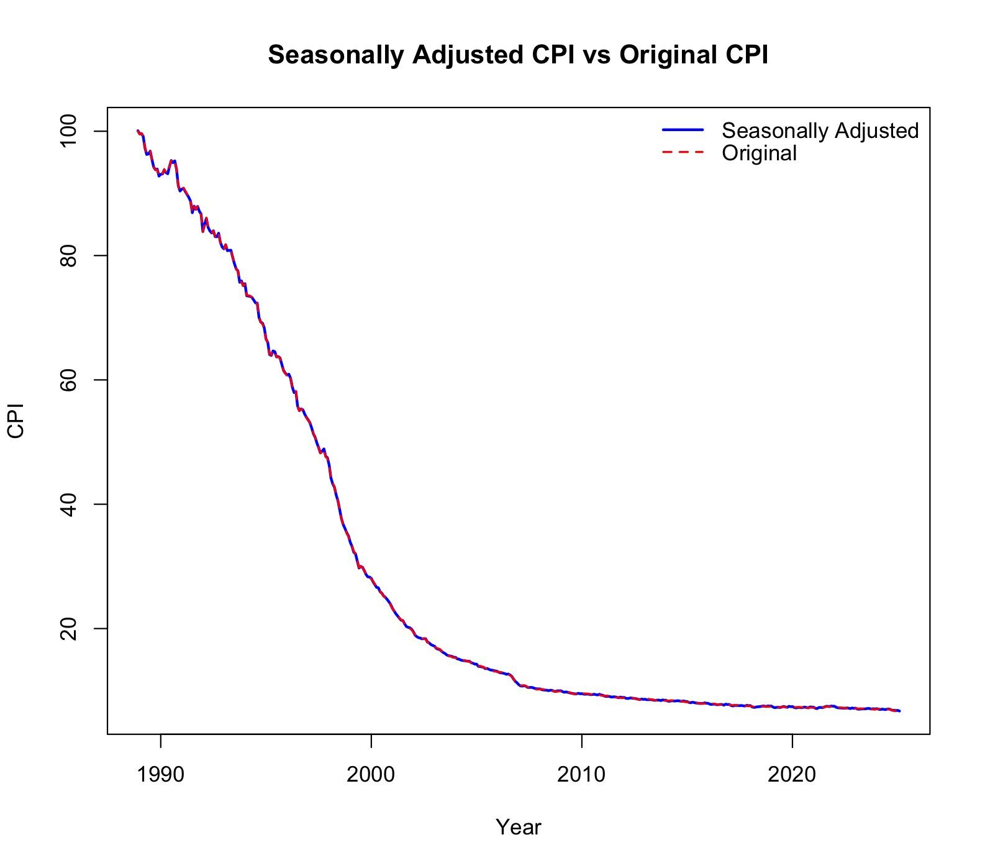
EDA: Decomposition & Seasonally Adjust
Very little seasonality
Trend is very smooth
No point in using seasonally adjusted data going foward

Slide 12
04.
Methodology and Models

Slide 13
M&M: Models & Tests to Use
Models
Naive
Simple Moving Average
Holt-Winters
ARIMA
Tests/Observations
Plot, ACF, & Histogram of residuals
Fitted/Actuals vs Residuals
Coefficients
Ljung-Box Test
Shapiro-Wilk Normality Test
Accuracy Measure
MAPE

Slide 14
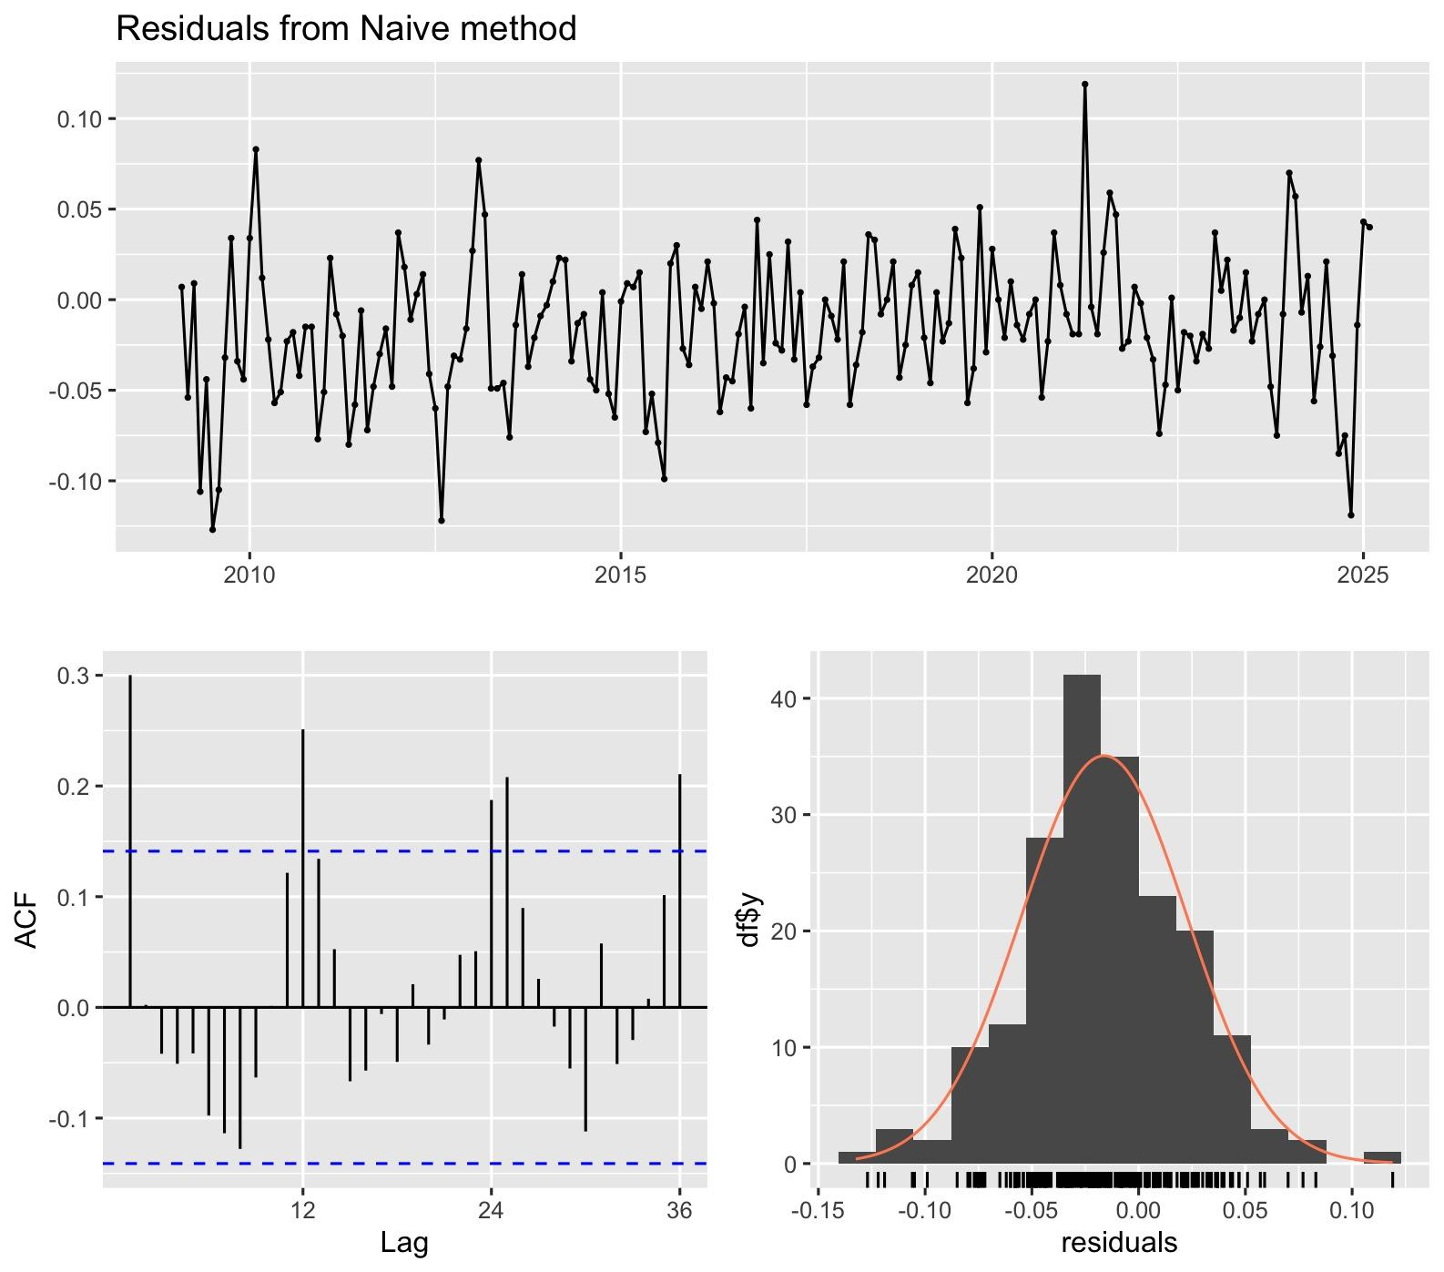
M&M: Naive
Residual Plot
Not as random looking as wanted
Clear autocorrelation at certain points
Acf of Residuals
Extreme autocorrelation
Spikes at lags 1,12,14, and 36
Residuals not acting like white noise
Model does not fully capture the data
Histogram of Residuals
Looks normally distributed
Slight skewness
Overall not bad

Slide 15
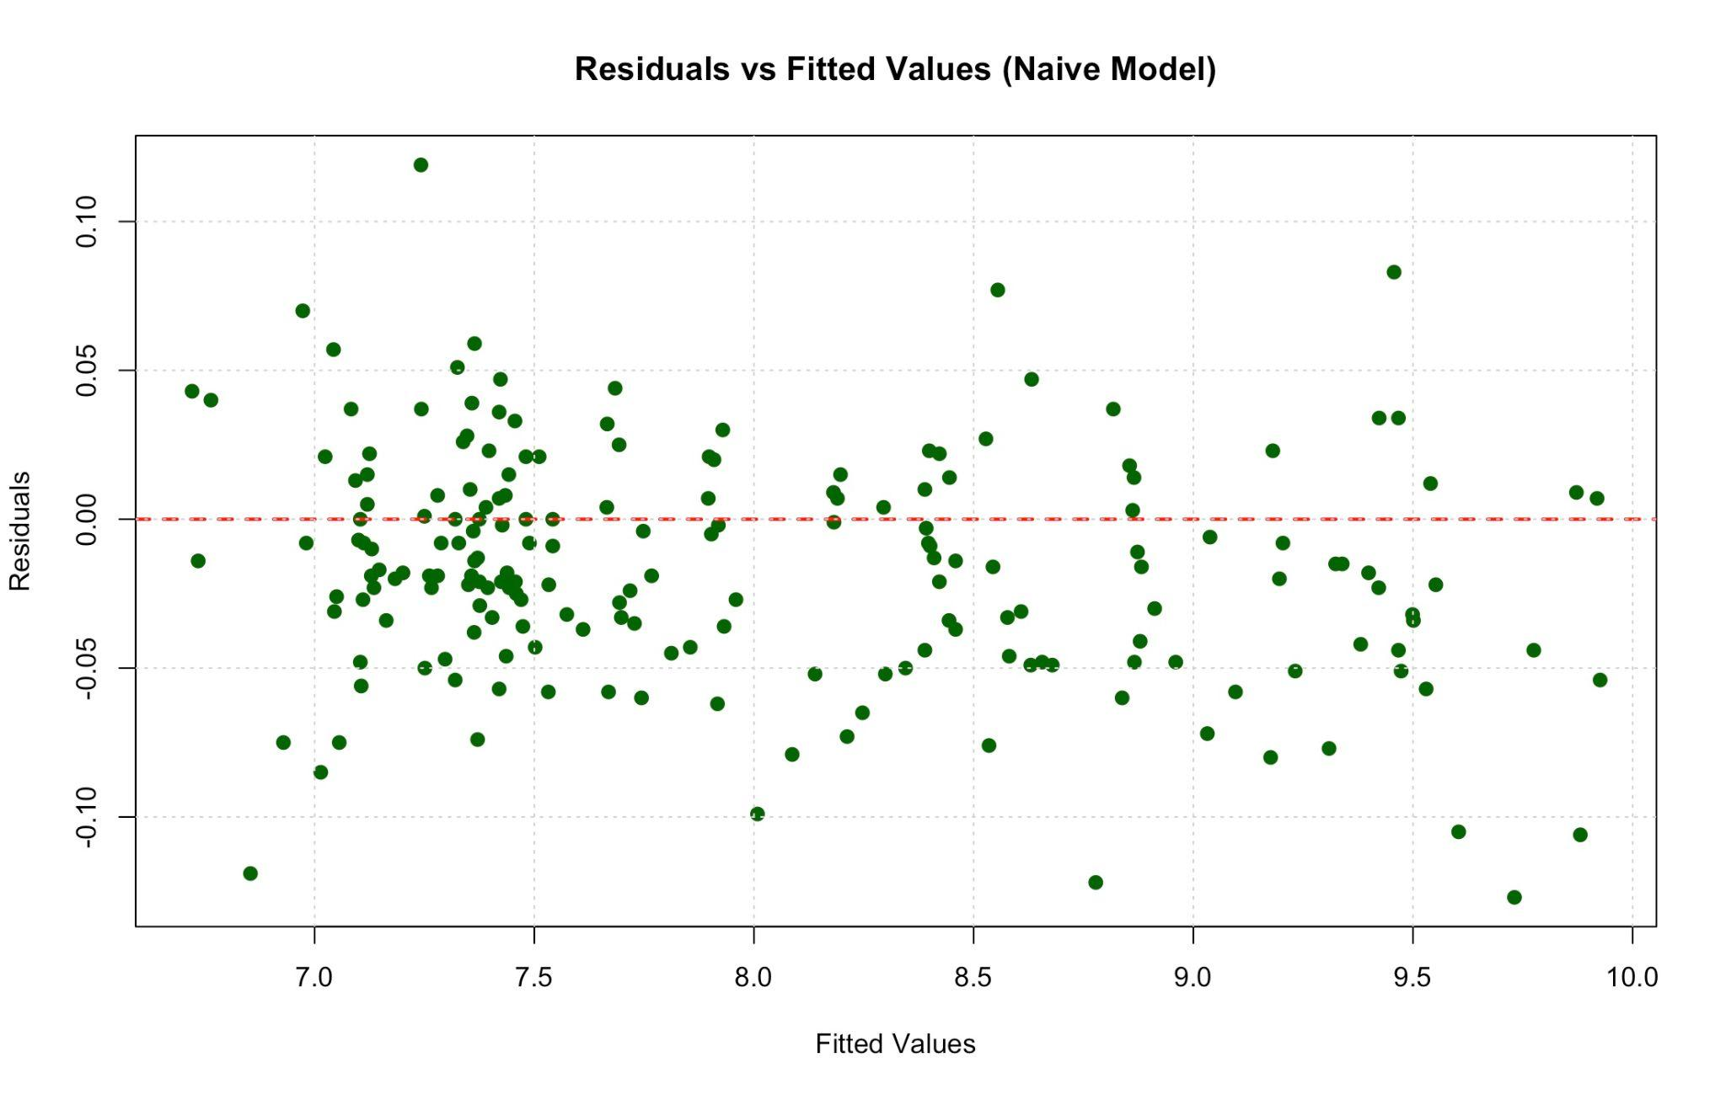
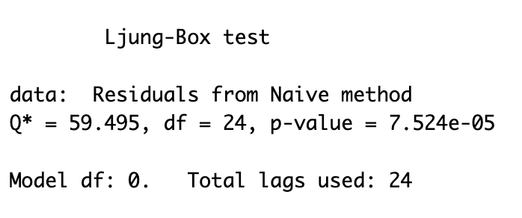
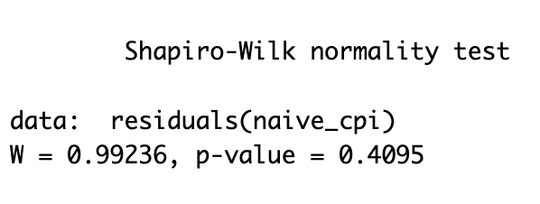
M&M: Naive
Residuals vs Fitted
Looks somewhat random
Not as spread out as would hope
Small clusters indicating the model fails to capture some aspects of the data
Ljung-Box Test
P-value of 7.524e-05 less than 0.05 threshold
Disproves that the residuals have no autocorrelation
Fails the test
Shapiro-Wilk Normality Test
P-value of 0.4095 greater than 0.05 threshold
Proves normally distributed residuals
Passes the test

Slide 16
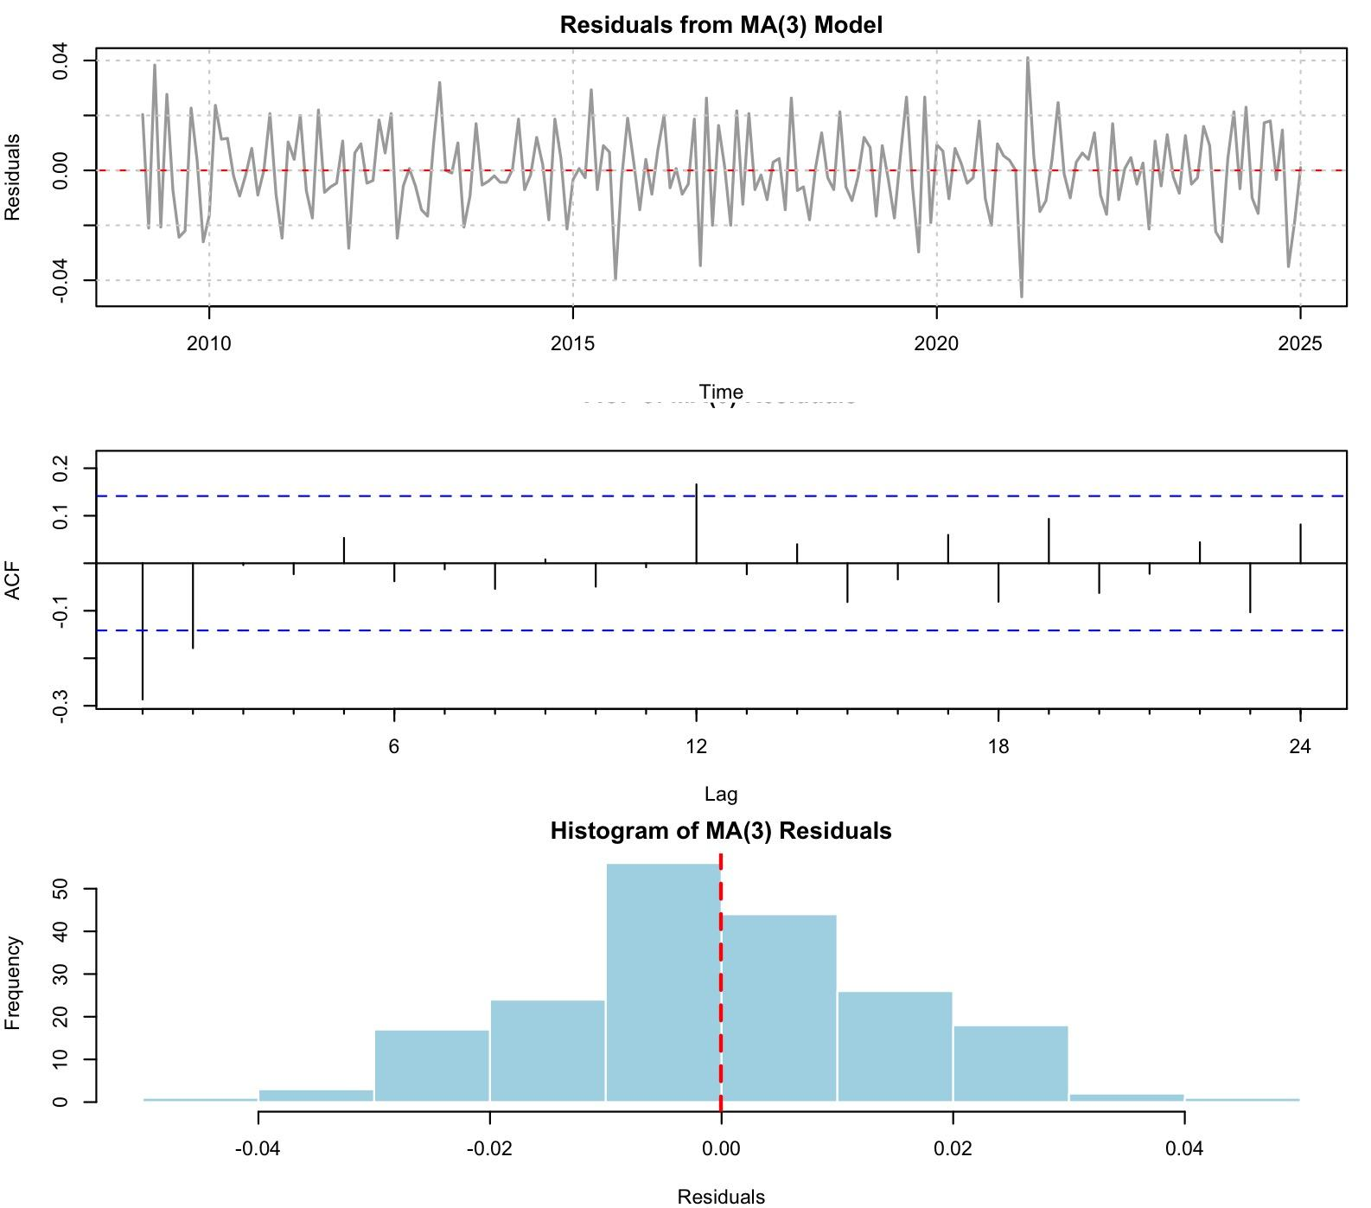
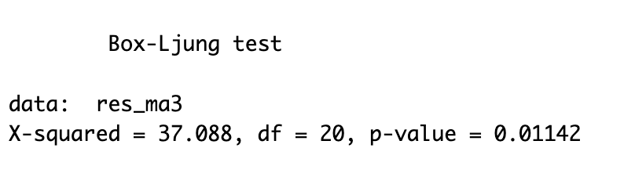
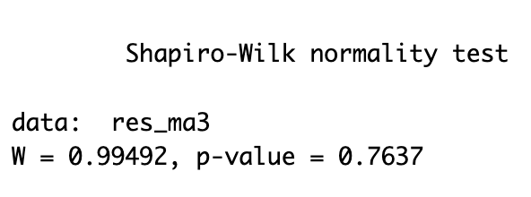
M&M: Simple Moving Averages
Residual Plot
More random looking then Naive model
Slight instances of autocorrelation
Acf of Residuals
Significantly better looking than Naive model
Some spikes indicating the model doesn’t completely capture everything
Histogram of Residuals
Very normally distributed
Ljung-Box Test
P-value of 0.01142 less than 0.05 threshold
Disproves that the residuals have no autocorrelation
Fails the test but different threshold could change this
Shapiro-Wilk Normality Test
P-value of 0.7637greater than 0.05 threshold
Proves normally distributed residuals
Passes the test

Slide 17
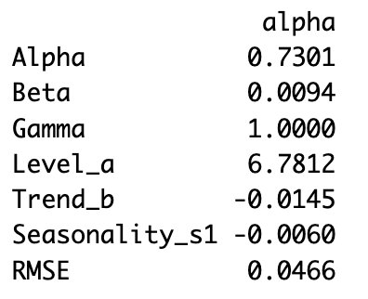
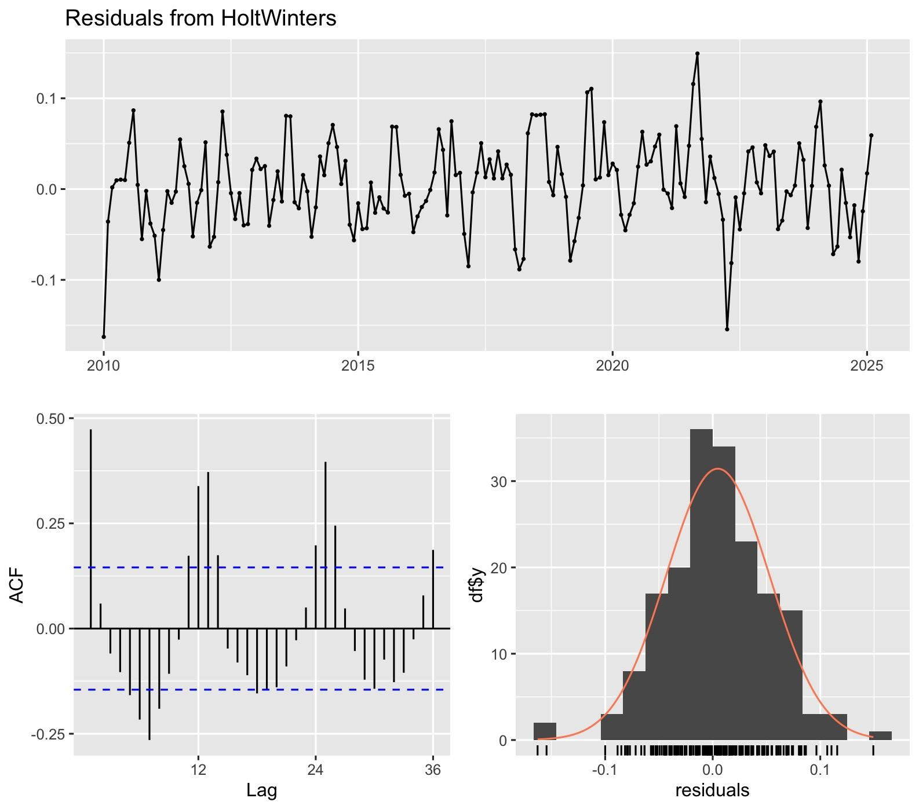
M&M: Holt-Winters cont.
Residual Plot
Not as random as wanted
Clear autocorrelation at certain points
Acf of Residuals
Extreme autocorrelation
Spikes at many lags
Model does not fully capture the data
Histogram of Residuals
Roughly bell shaped
Slight skewness
Overall not bad
Alpha (0.73): Model reacts quickly to new data.
Beta (0.0094): Stable Trend
Gamma (1.0): Strong seasonal updates each period.
RMSE (0.0466): Low prediction error overall.

Slide 18
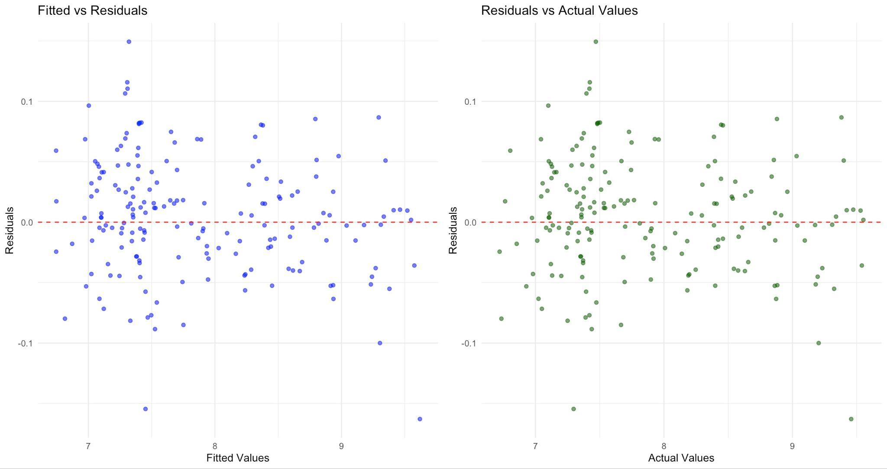
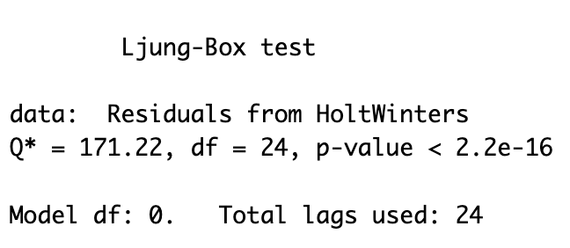
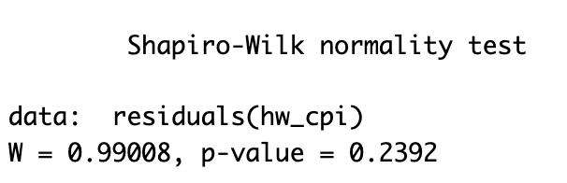
M&M: Holt-Winters cont.
Residuals vs Fitted & Residuals vs Actuals
No clear signs of relationship
Not as spread out as would hope
Small clusters indicating the model fails to capture some aspects of the data
Ljung-Box Test
P-value of 2.2e-16 less than 0.05 threshold
Disproves that the residuals have no autocorrelation
Fails the test
Shapiro-Wilk Normality Test
P-value of 0.2392 greater than 0.05 threshold
Proves normally distributed residuals
Passes the test

Slide 19
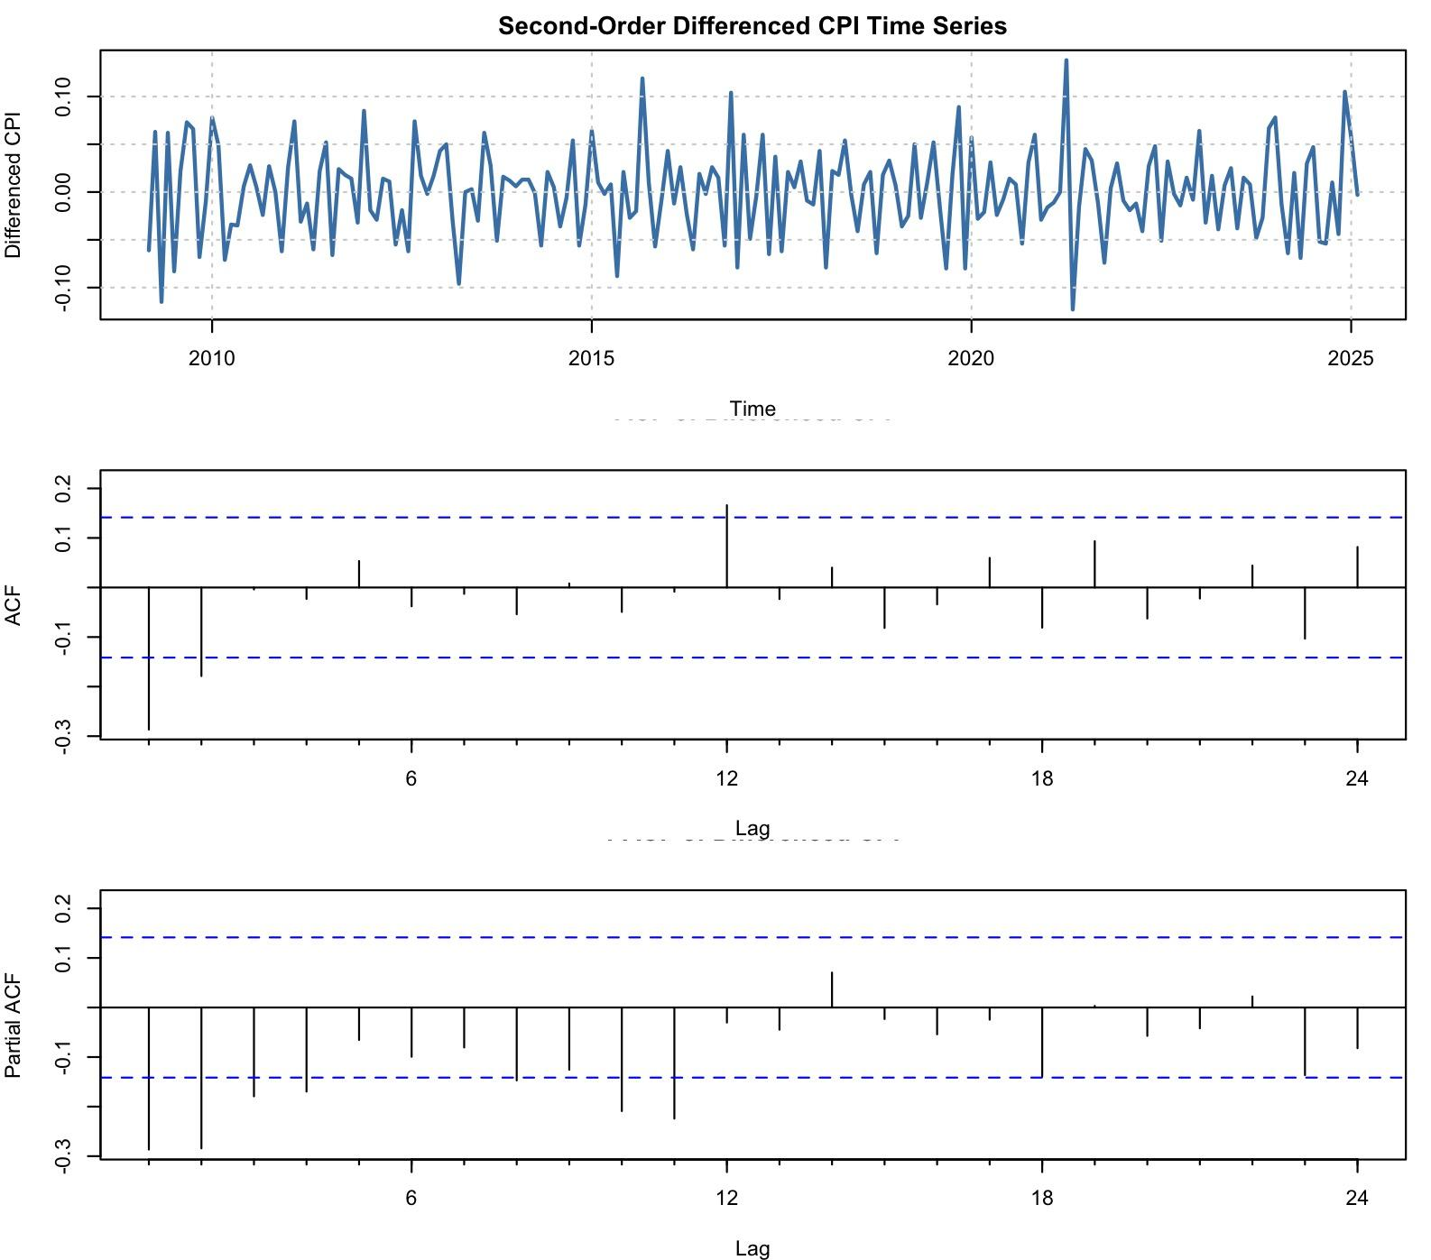
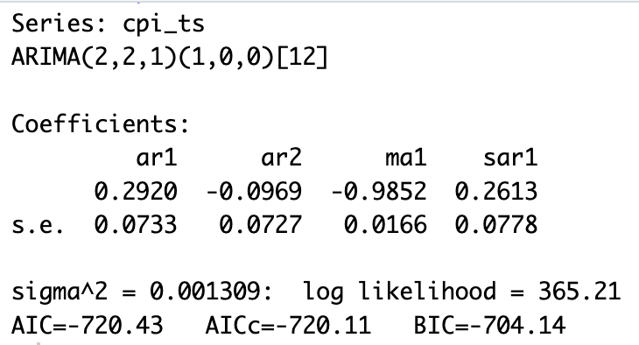
M&M: ARIMA
Differenced Plot
0 Seasonal differences and 2 non-seasonal differences
Acf
Suggests no strong autocorrelation
Most components have been removed
Pacf
No clear AR structure remaining
Coefficients
Variance is small which is good

Slide 20
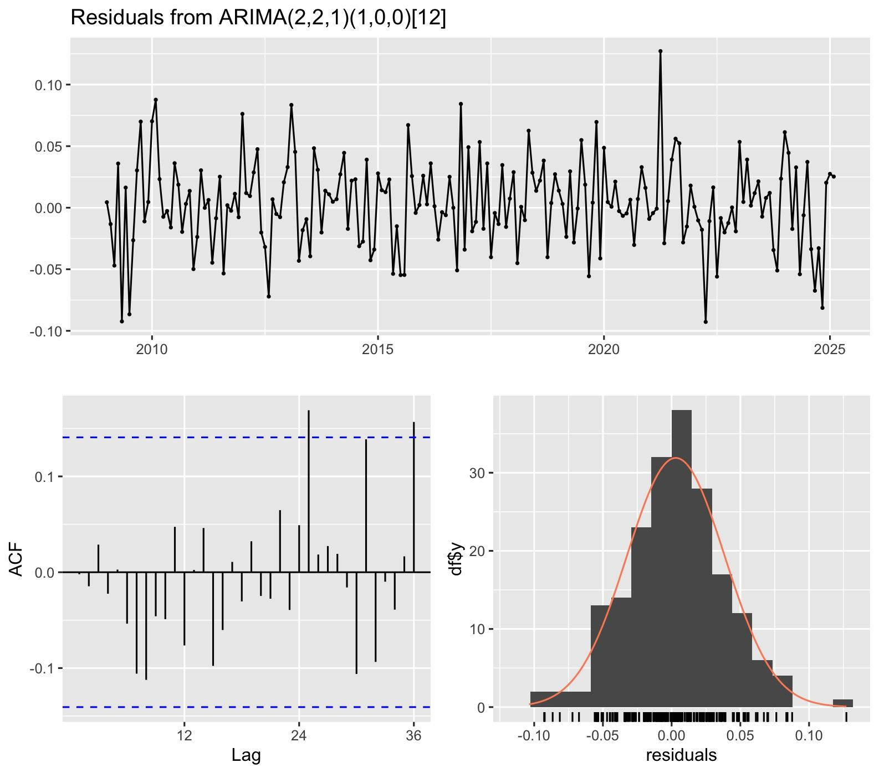
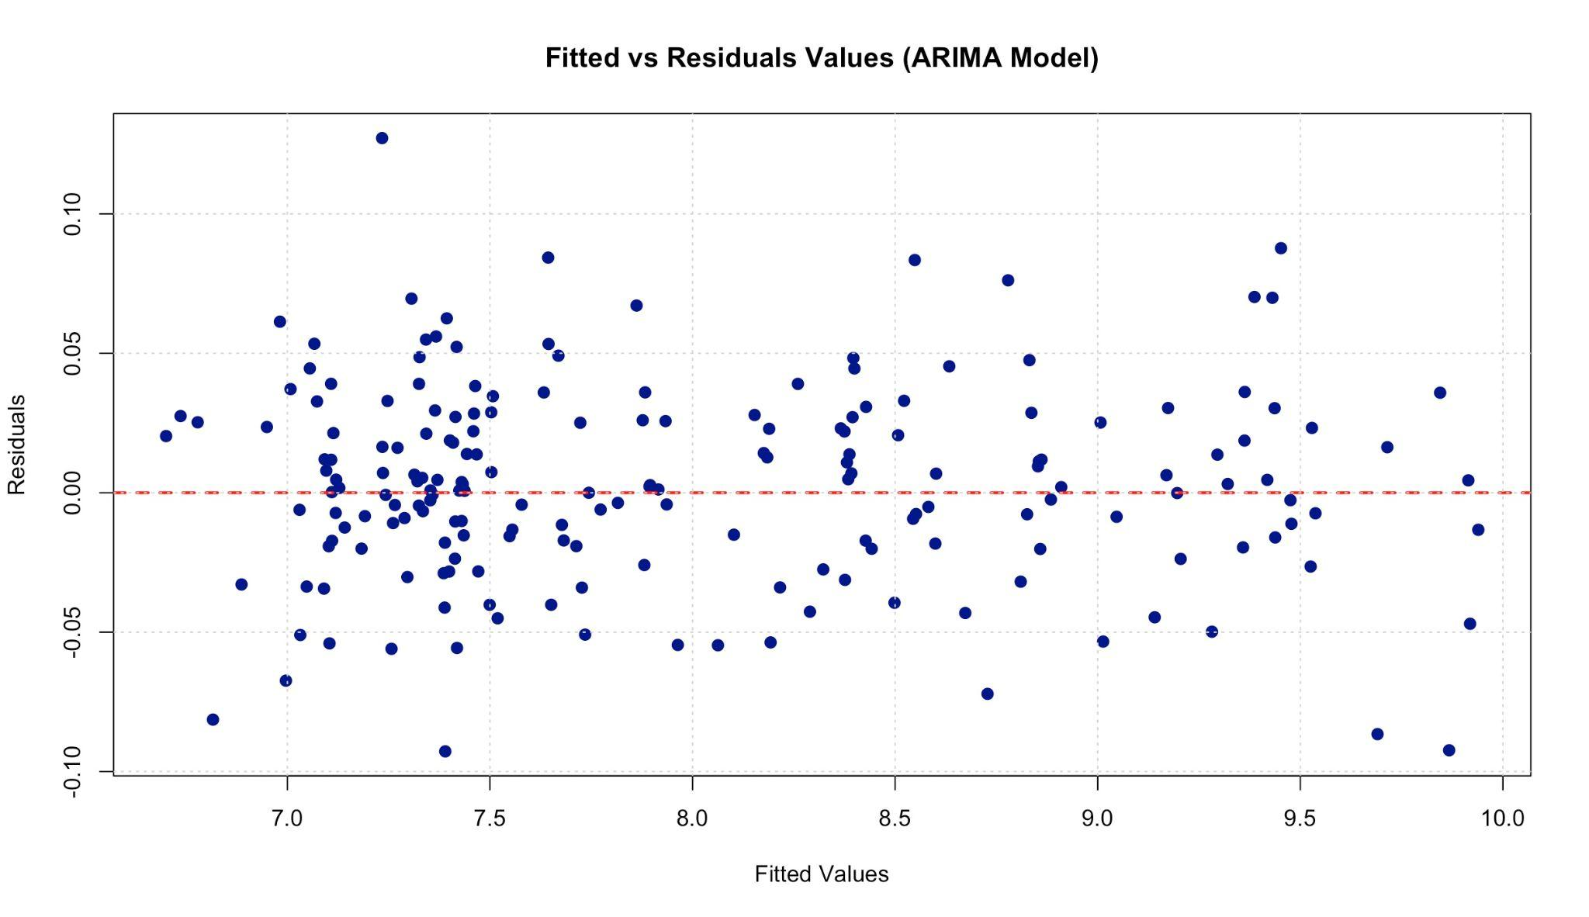
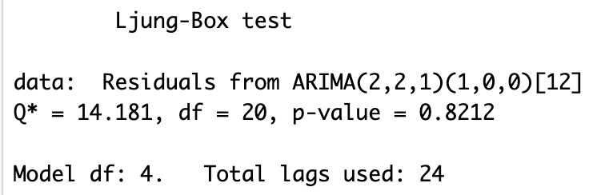
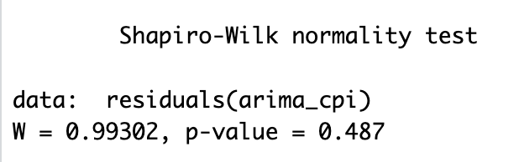
M&M: ARIMA cont.

Slide 21
M&M: ARIMA cont.
Residuals vs Fitted
No clear signs of relationship
Looks a little more spread out than other models
Small clusters indicating the model fails to capture some aspects of the data
Ljung-Box Test
P-value of 0.8212 greater than 0.05 threshold
Proves that the residuals have no autocorrelation
Passes the test
Shapiro-Wilk Normality Test
P-value of 0.487 greater than 0.05 threshold
Proves normally distributed residuals
Passes the test

Slide 22
05.
Final Model Selection

Slide 23
Two Best Models: ARIMA and Simple Moving Average
ARIMA
Best residual plot, Acf, and Histogram
Fitted vs Actuals seems random and spread out
Very low sigma^2 indicating less variance in model errors
Only model to pass both Ljung-Box test and Shapiro-Wilk Test.
Simple Moving Average
Also very good residual plot, and Acf but a better Histogram
Better Shapiro-Wilk Test than ARIMA and was the next closest model to passing Ljung-Box Test

Slide 24
06.
Forecast

Slide 25
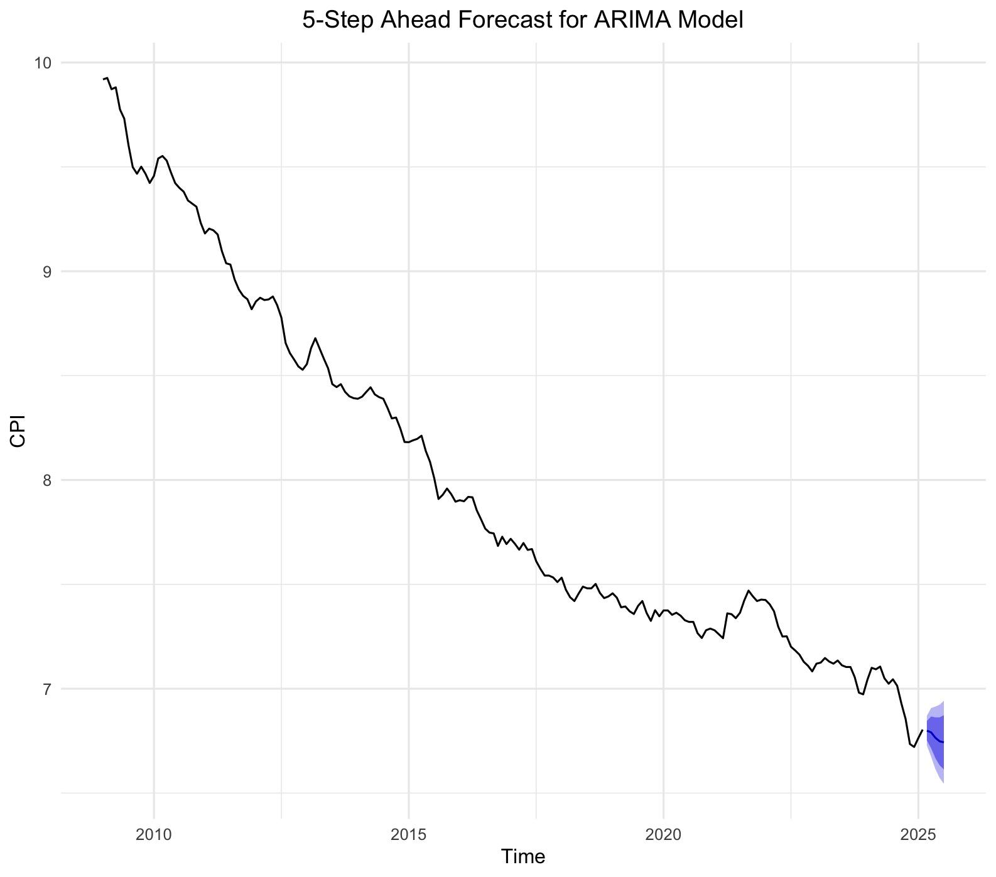
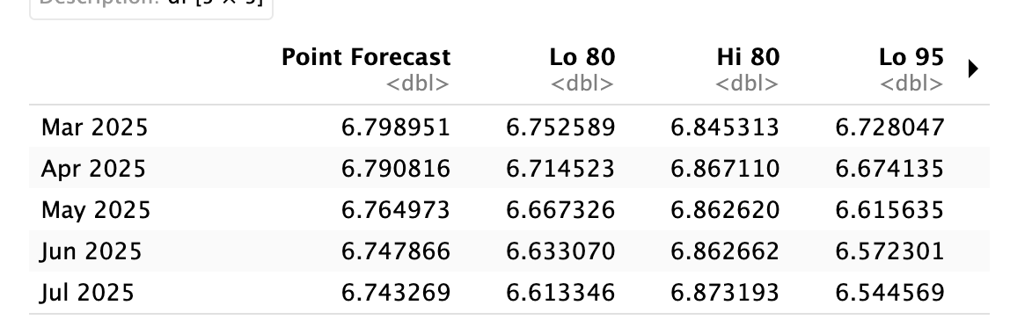
Forecast: ARIMA(2,2,1)(1,0,0)[12]
CPI is expected to slightly decrease over the next 5 months.
Predicted values gradually drop from 6.80 to 6.74.
80% and 95% prediction bands are tight, showing good confidence.
The forecast line is smooth suggesting stable short-term behavior.
Continues the downward trend seen in historical data — consistent model behavior.

Slide 26
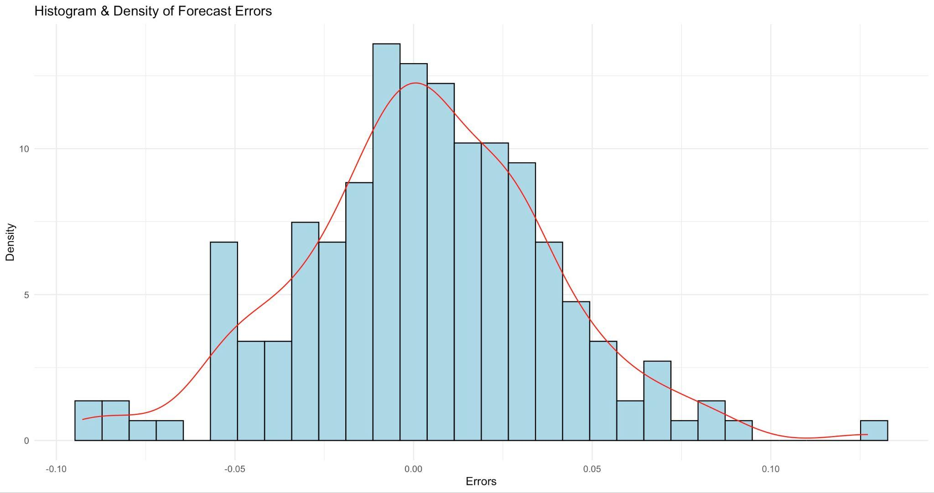
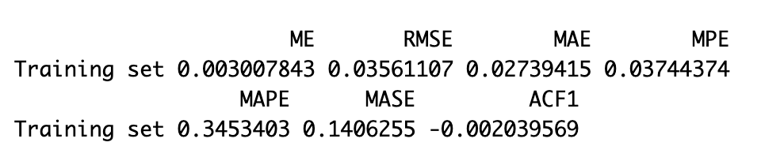
Forecast: ARIMA(2,2,1)(1,0,0)[12]
Histogram & Density Plot
Roughly bell shaped
Slight right skewness indicating underforcasting
Accuracy Measures
MAPE is 0.345; ok accuracy
ME proves underforcasting
Overall a good model but can be improved upon

Slide 27
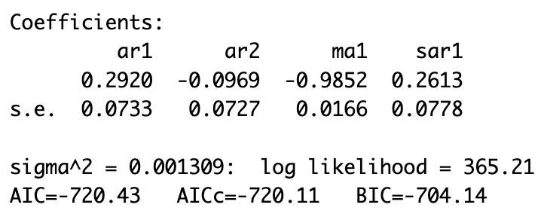
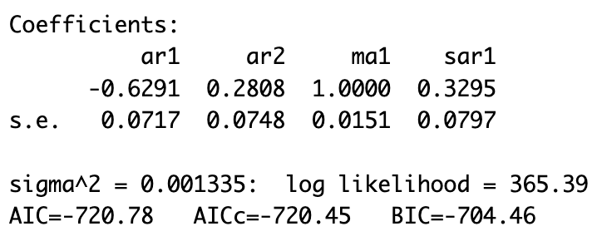
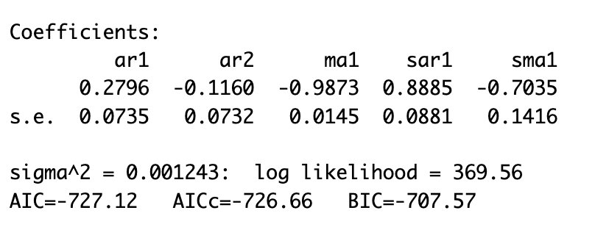
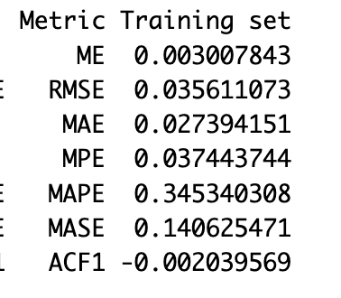
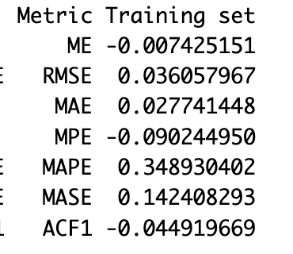
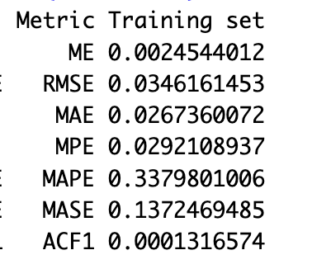
Forecast: Adjusted ARIMAs
Original
(2,1,1)(1,0,0)[12]
(2,2,1)(1,0,1)[12]

Slide 28
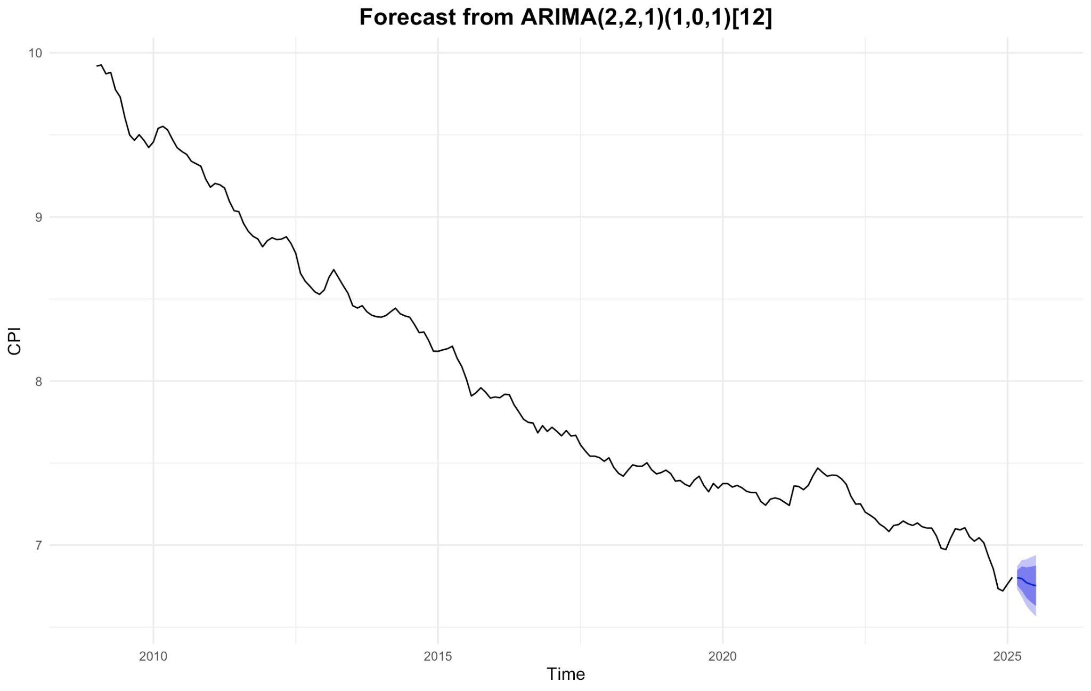
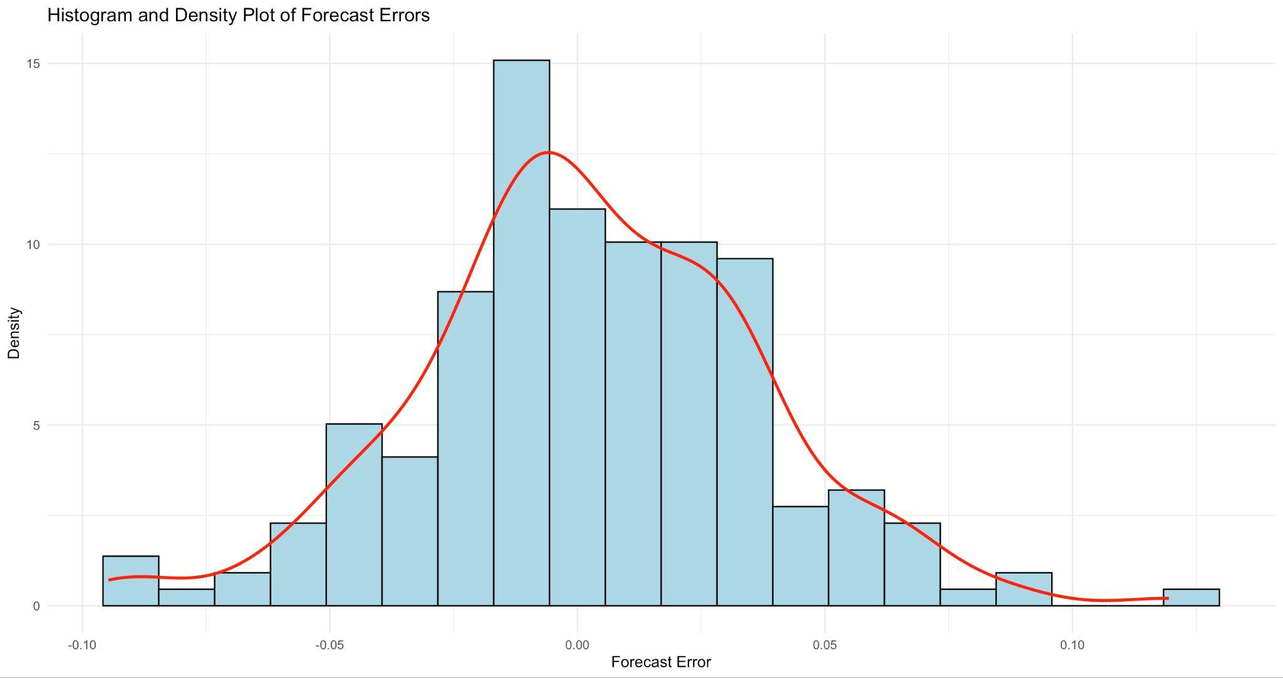
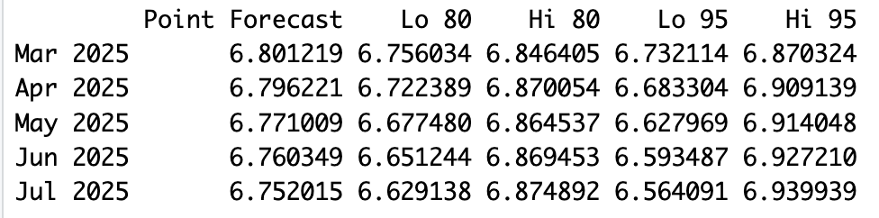
Forecast: ARIMA(2,2,1)(1,0,1)[12]
Very similar to original model, only slightly better in every way.
Still under forecasts

Slide 29
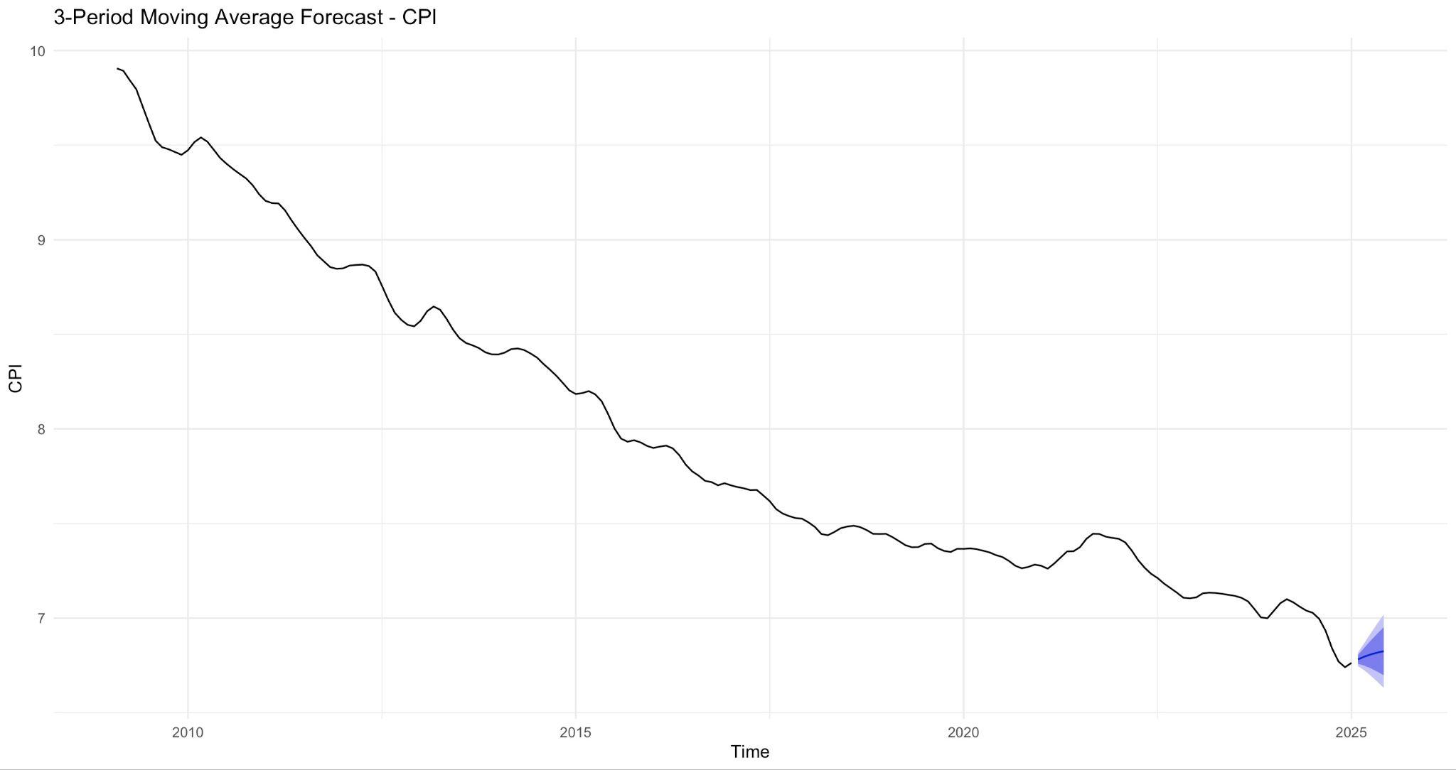
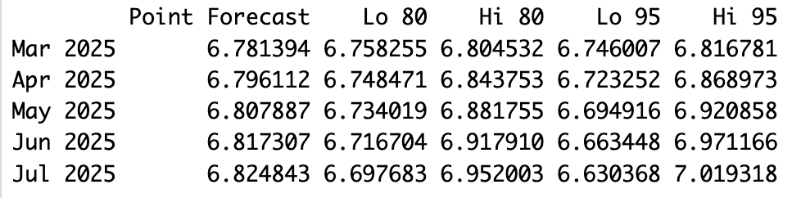
Forecast: Simple Moving Average(3)
CPI is forecasted to slightly increase from 6.78 to 6.82 over the next 5 months.
Shows a flattening trend compared to the long-term decline.
Confidence intervals widen slightly, indicating growing uncertainty.
Forecasts are tightly packed, showing a stable, smoothed outlook.

Slide 30
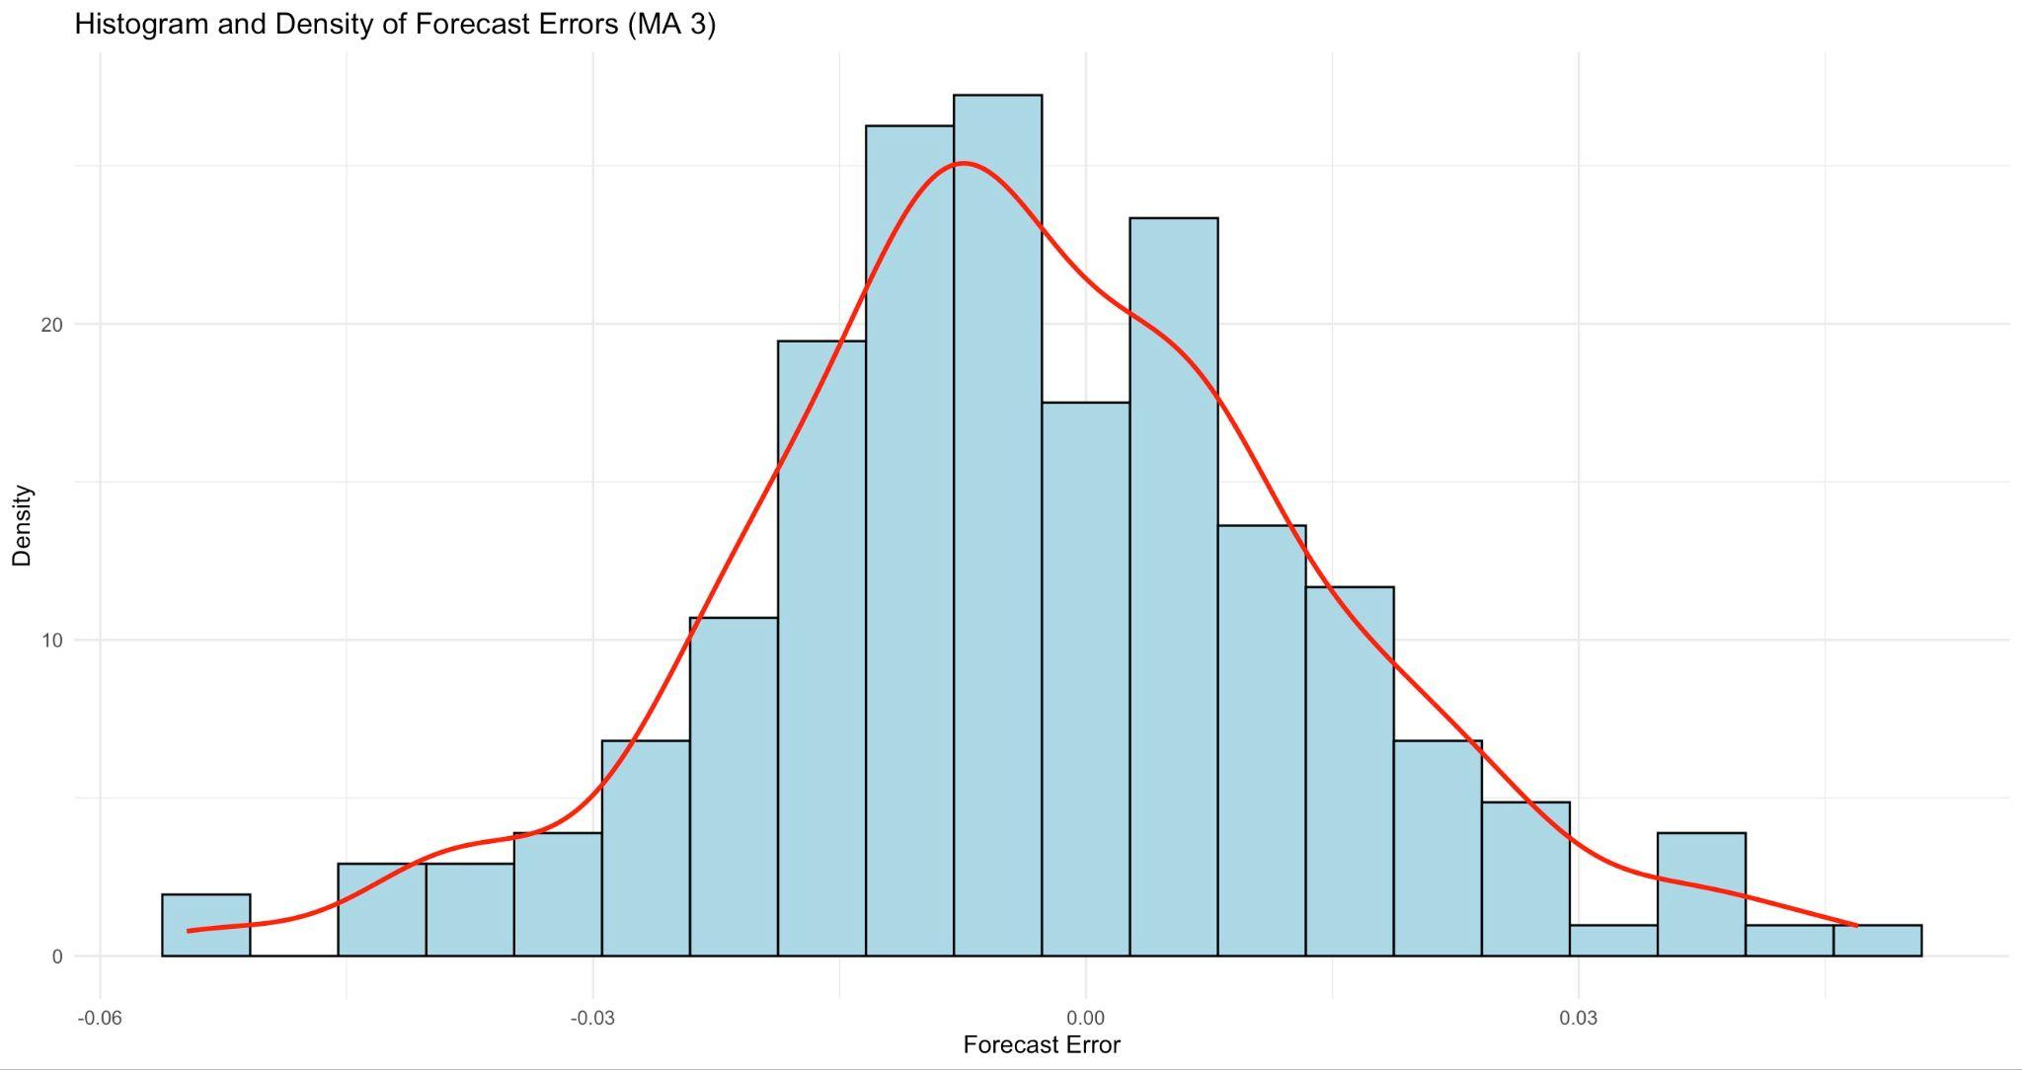
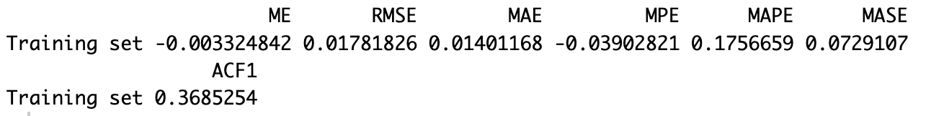
Forecast: Simple Moving Average(3)
Histogram and Density Plot
Roughly bell shaped
Not perfectly distributed
Accuracy Measures
MAPE is .176
Model is more accurate than ARIMA
Tends to over forecast slightly
Not as statistically sound as ARIMA with higher Acf1

Slide 31
07.
Conclusion

Slide 32
Conclusion & Recommendation
ARIMA
Simple Moving Average(3)
Implications:
The best model to use depends on the horizon and the specific need
The ARIMA is more robust and statistically sound
The Simple MA(3) is more accurate
For long term forecasting, choose ARIMA
For short term forecasting, choose Simple MA(3)

Slide 33
Thank you!
Any Questions?

